Slide 1
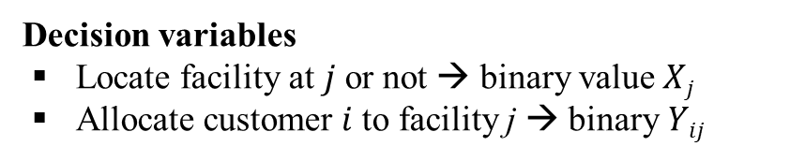
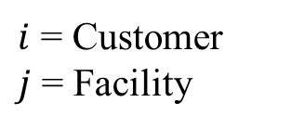
Facility Location Using a Distance-Based Approach: P-Median Problem
Need to locate facilities and allocate customers to the facility → to minimize the total distance traveled
$i$ = Customer
$j$ = Facility
Decision variables
Locate facility at $j$or not → binary value $Xj$
Allocate customer $i$to facility j → binary $Yij$
Total demand weighted distance
Each demand (Customer) assigned once to the facility(ies)
Maximum number of facilities to locate
Cannot assign demands (customers) to an unopened facility

